Slide 1



Apache Spark and Mllib
Preformed by: Amir Amemi
Houcem Gharbi

Slide 2
Table of contents
01
02
Apache Spark Overview
MLlib Introduction
03
Working with MLlib
04
Conclusion
Notes:
So, we divided our project into 4 main parts , witch are Apache Spark , What ‘s Mllib and the value added , a Small example of how Mllib works and we close with the a Conclusion
Oh, And d’nt worry about taking notes, i’ll be handling out copies of the power point slides .

Slide 3
Apache Spark Overview
01
What is Apache Spark?
Why Apache Spark ?
Apache Spark Components
Notes:
In this section , i would like to report on apache spark overview ;
What is Apache Spark?
Why Apache Spark ?
Apache Spark Components

Slide 4
What is Apache Spark?
Notes:
As we move to the next slide, you might be wondering, what’s Apache Spark?

Slide 5
What is Apache Spark ?
Open Source
Fast
MapReduce
Big Data
O
F
Freely available for anyone to download and use.
Utilizes in-memory caching for intermediate data storage
M
B
Supports
batch processing
Ingest and clean large datasets
Notes:
1- Apache Spark is an open-source framework. making it freely available for anyone to use 2-Utilizes in-memory caching for intermediate data storage that’s why its fast
3- and it supports batch processing by using mapReduce
4- also ingest and clean large datasets

Slide 6
Why Apache Spark?
Notes:
Why apache spark , This selection is underpinned by several strategic advantages:

Slide 7
Why Apache Spark ?
Efficiency
Versatility
Performance
Community
Fast, Distributed Data Processing Framework
Versatile and Unified Platform
In-Memory Computing for High Performance
Ongoing development and resources from a vibrant community
Notes:
Which are Efficiency , versatility , Performance and Community 1- First of all I’ll be talking about Efficiency , its Fast, Distributed Data Processing Framework and its Significantly faster than traditional data processing tools, thanks to in-memory computing.
2- Secondly versatility : it means Versatile and Unified Platform Supports various data processing tasks, including batch processing, interactive queries, streaming, and machine learning
Third , In-Memory Computing for High Performance
And last but not least Community Ongoing development and resources from a vibrant community

Slide 8
Apache Spark Components
Notes:
this slide we’re going to talk about 4 components

Slide 9
Apache Spark Components
2012
2013
2014
2014
Spark Streaming
MLlib
Spark SQL
GraphX
Processes real-time data streams using micro-batch processing
A rich library for scalable machine learning tasks
Allows querying structured data using SQL within Spark applications
A graph processing library for analyzing graph-structured data
Notes:
In 2012, Spark Streaming was introduced, allowing Processes real-time data streams using micro-batch processing
The year 2013 saw the introduction of Mllib , it’s a A rich library for scalable machine learning tasks
2014 marked a pivotal moment with the addition of Spark SQL allowing querying structured data using SQL within Spark applications*
Additionally, the same year witnessed the introduction of GraphX it’s a graph processing library for analyzing graph-structured data

Slide 10
Mllib Introduction
02
Introduction to Mllib
MLlib Components
Why MLlib?
Notes:
No let’s delve into the world of Mllib
We are going to provide a clear and engaging overview about
Introduction to Mllib
MLlib Components
Why MLlib?

Slide 11
Definition
MLlib, Apache Spark's dedicated library,
simplifies and accelerates development of scalable
distributed machine learning applications.
Notes:
MLlib, Apache Spark's dedicated library, simplifies and accelerates development of scalable distributed machine learning applications.

Slide 12
MLlib Components
Notes:
this slide we’re going to talk about 4 components witch are

Slide 13
MLlib Components
Classification
Regression
Clustering
Collaborative Filtering
C
R
Involves categorizing data points into predefined classes or labels
Predicts a continuous outcome based on input features
C
C
Groups similar data points into clusters based on inherent patterns
Recommends items or content based on the preferences and behaviors of similar users
Notes:
Classification , Regression , Clustering , Collaborative Filtering
Starting with Classification , it Involves categorizing data points into predefined classes or labels
Regression , it Predicts a continuous outcome based on input features
Clustering , it Groups similar data points into clusters based on inherent patterns
And Collaborative Filtering , it Recommends items or content based on the preferences and behaviors of similar users

Slide 14
Why MLlib?
Notes:
Two of MLlib's standout features is its tight integration with Apache Spark and it’s scalability

Slide 15
Integration
Scalability
MLlib seamlessly integrates with Spark's ecosystem, including Spark Core, Spark SQL, and Spark Streaming
MLlib is designed to scale horizontally, enabling the processing of large datasets across a distributed computing cluster
Notes:
Integration , it seamlessly integrates with Spark's ecosystem, including Spark Core, Spark SQL, and Spark Streaming
Scalability , it ‘s designed to scale horizontally, enabling the processing of large datasets across a distributed computing cluster

Slide 16
Working with MLlib
03
Notes:
In this slides we’r going to show you a small exemple of how we can utilize Mlib

Slide 17
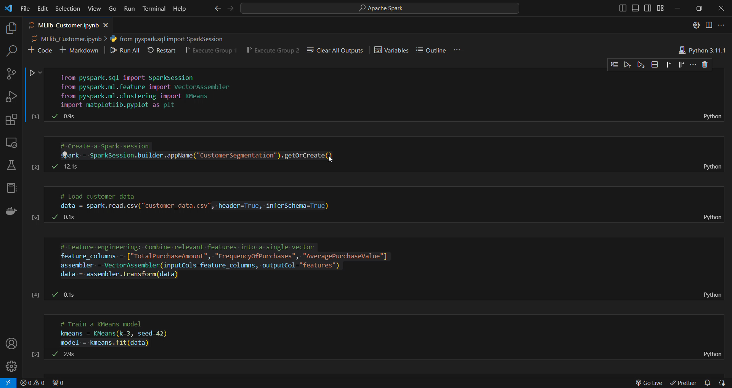

Code Demo
This code demonstrates the use of Apache Spark's MLlib for customer segmentation using the KMeans clustering algorithm.
Notes:
This code demonstrates the use of Apache Spark's MLlib for customer segmentation using the KMeans clustering algorithm.

Slide 18
Conclusion
04
Notes:
And here’s a little demonstration

Slide 19
Conclusion
04
Notes:
To summ up

Slide 20
Conclusion
MLlib
Efflexibility
Apache Spark
Through a small example employing MLlib (Python Code), we've demonstrated its simplicity and efficiency, especially evident in tasks such as KMeans clustering
Apache Spark stands out as a fast and distributed data processing framework
MLlib emerges as a fundamental component, dedicated to machine learning tasks within Apache Spark
Notes:
Apache Spark stands out as a fast and distributed data processing framework
MLlib emerges as a fundamental component, dedicated to machine learning tasks within Apache Spark
Through a small example employing MLlib (Python Code), we've demonstrated its simplicity and efficiency, especially evident in tasks such as KMeans clustering

Slide 21
THANK YOU !

